Slide 1
What drives a parent’s decisions when choosing a name?
Alla Zbirun
Gizem Yali-Pepper
Hernan Hernandez
Mike Boccio
Ray Fendi

Slide 2
Motivations
Curiosity about cultural differences across the United States.
It is known that names change over locations and times. What drives these changes?
Are there external factors that influence parents' decision making?
Quality and ease of available data.
Choosing a name is a defining moment for both parents and children.

Slide 3
Questions
What are the most popular names in each state and what are the commonalities?
Are there differences in name choices in blue states and red states?
Is there a relationship between a child’s name and popular culture?

Slide 4
Executive Summary
Name diversity increases over time
In some cases, there is a relationship between popular culture and the popularity trend of a name. When a unique name appeared in popular culture there was a resulting rise in parents choosing that name for their child.
We found minimal difference between the naming choices of red and blue states when considering the most popular names. The most popular names tend to be ubiquitous across the United States.

Slide 5
Hypothesis
Parents in red states favor more conventional and gender-neutral names, while parents in blue states tend to go for more traditional and ethnically diverse names.
The frequency of a baby name during the height of a celebrity's popularity will be equal to the frequency of a baby name before/after the celebrity's popularity.

Slide 6
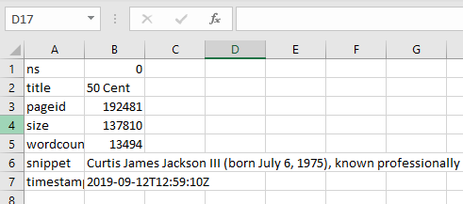
Data Cleanup & Exploration
Sources
Kaggle
Big Query API
CSV files from the Social Security Administration
Wikipedia
Used for gathering celebrity names across pop culture
Used to gather 2012 and 2016 election data for red states and blue states

Slide 7
Data Cleanup & Exploration
Data Cleanup
Importing data from 51 CSV files and concatenating data
Replacing counts of names that did not appear in a specific state (NaN) with a count of 0
Splitting first name and last name in Wikipedia data
Creating bins for each decade
Wrote code to search data frame and simultaneously write output into a new data frame while plotting bar charts

Slide 8
Data Cleanup & Exploration
Interesting findings during Data Exploration
More males are born compared to females and the gap grows over time
Diversity of names increases over time
Females have more diverse names compared to males

Slide 9
Data Analysis
Question 1 – name popularity and diversity
Cut data into various views to analyze by gender, decade and state
Created charts to show most popular names and diversity
Question 2 - red and blue states
Used Glob module to import all txt files at once
Created US Map of with GeoPandas Python library
Question 3 – relationship of names to popular culture
Plotted total number of children with a given name of chosen celebrities observed over 12 decades
Used information available from Wikipedia to analyze amount of children with respective names in each decade

Slide 10
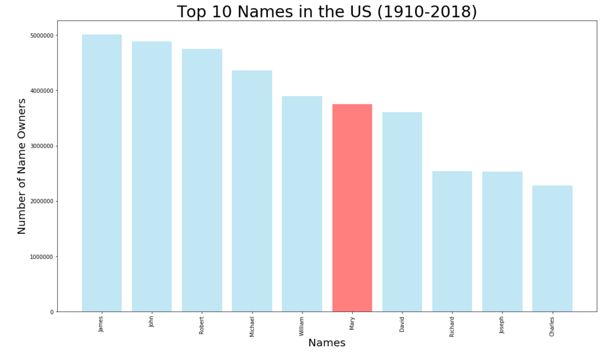
Findings
Among the top 30 names in the US from 1910-2018, only 3 of them are female names.
This indicates to a greater diversity among female names.
Additionally, religion had a huge impact in the top noes in the US.

Slide 11
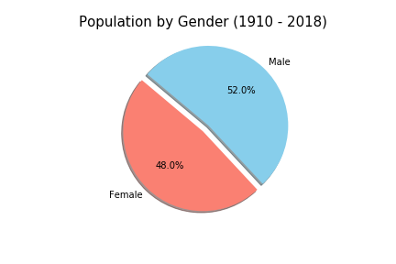
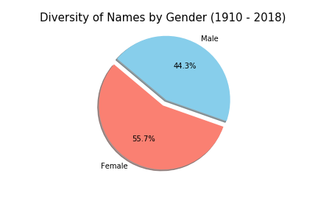
Findings

Slide 12
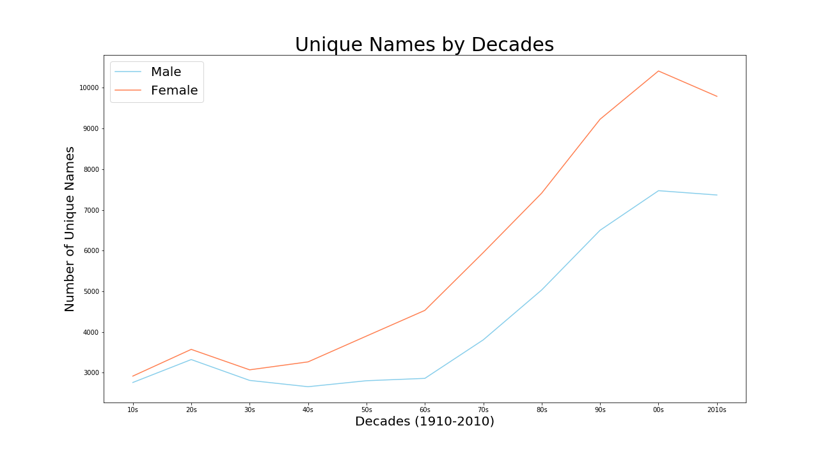
Findings
Diversity in the names increases throughout the decades, although female names remain more diverse than male names.

Slide 13
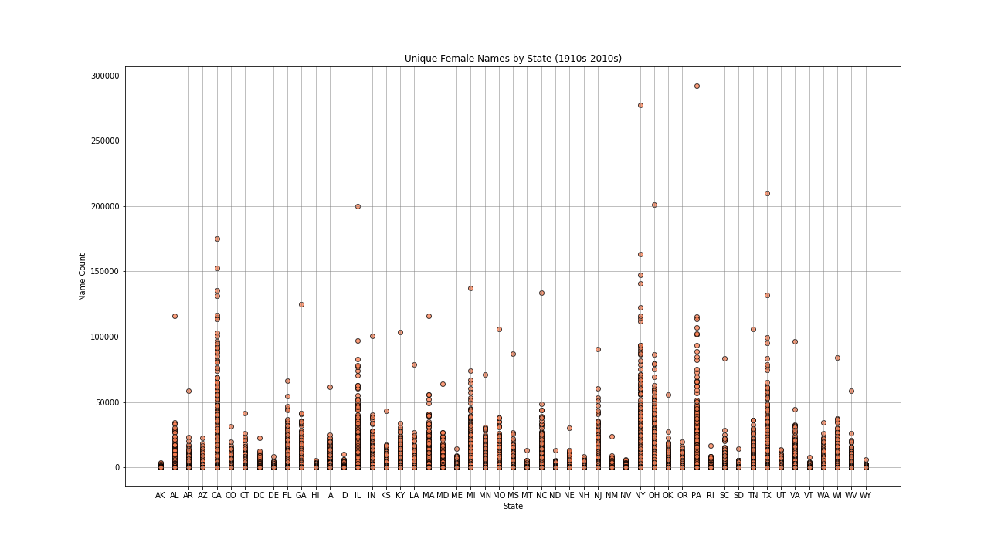
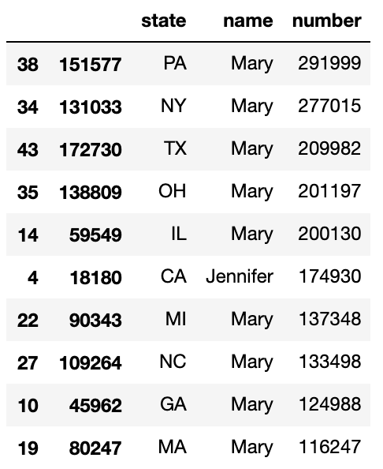
Findings
States with large cities have higher number of unique names among females.

Slide 14
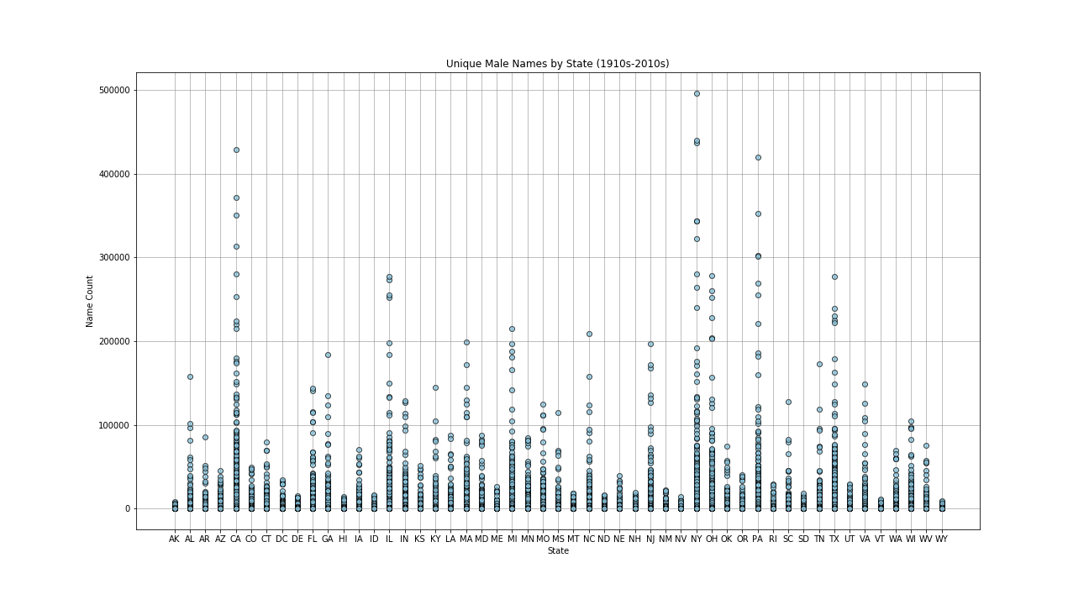
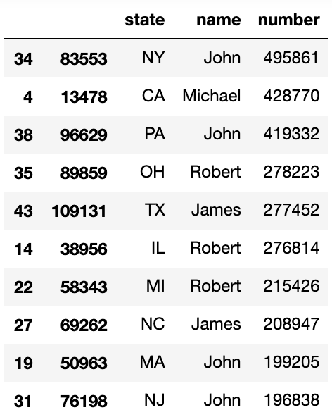
Findings
States with large cities have higher number of unique names among males.

Slide 15
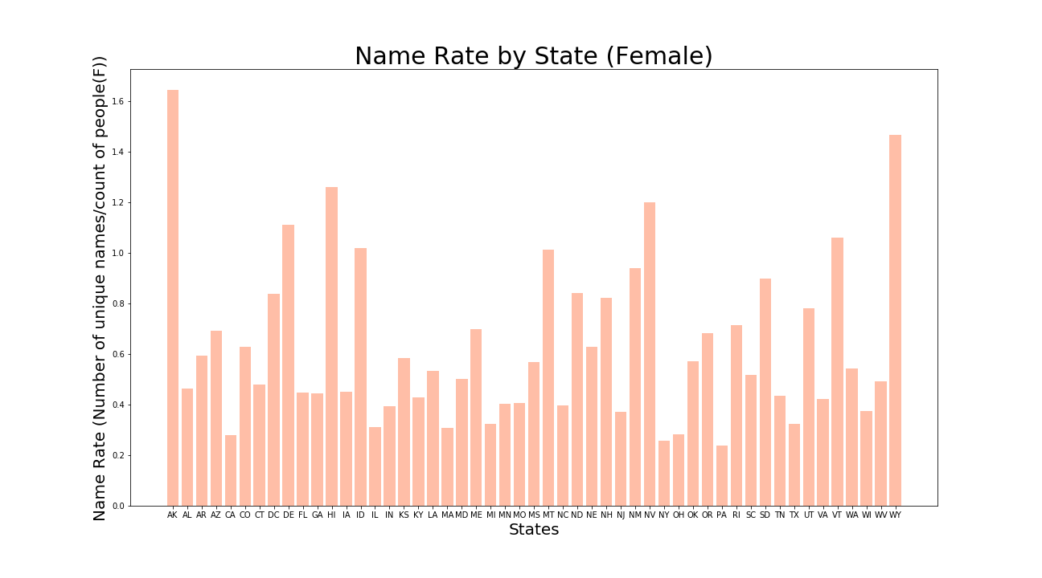
Findings
When we look at unique name rate, we see that actually smaller states have more unique names vs. the number of people in that state.

Slide 16
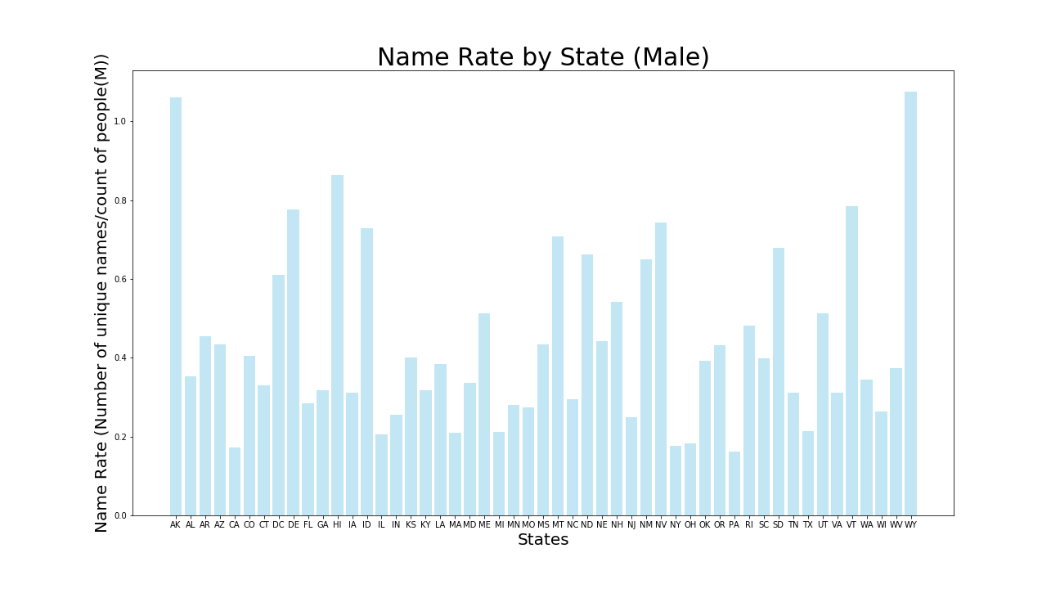
Findings
When we look at unique name rate, we see that actually smaller states have more unique names vs. the number of people in that state.
This has seen both among female and male names.

Slide 17
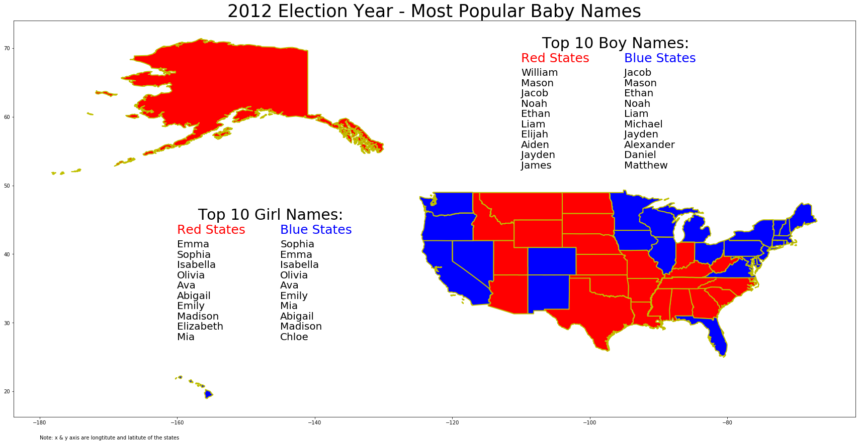
Findings

Slide 18
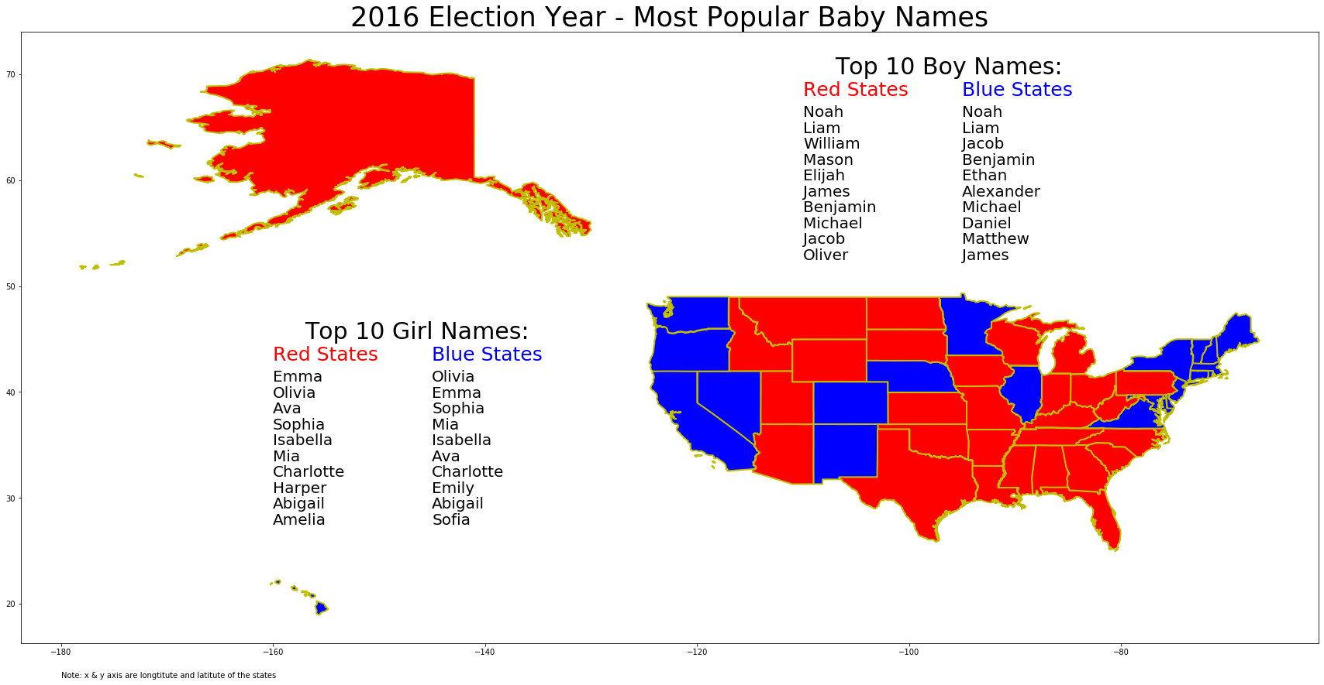
Findings

Slide 19
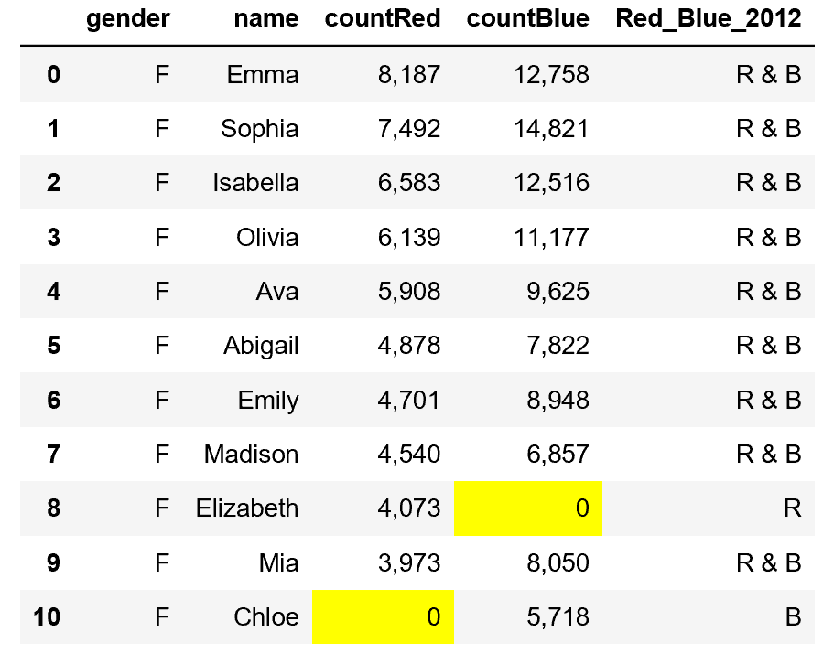
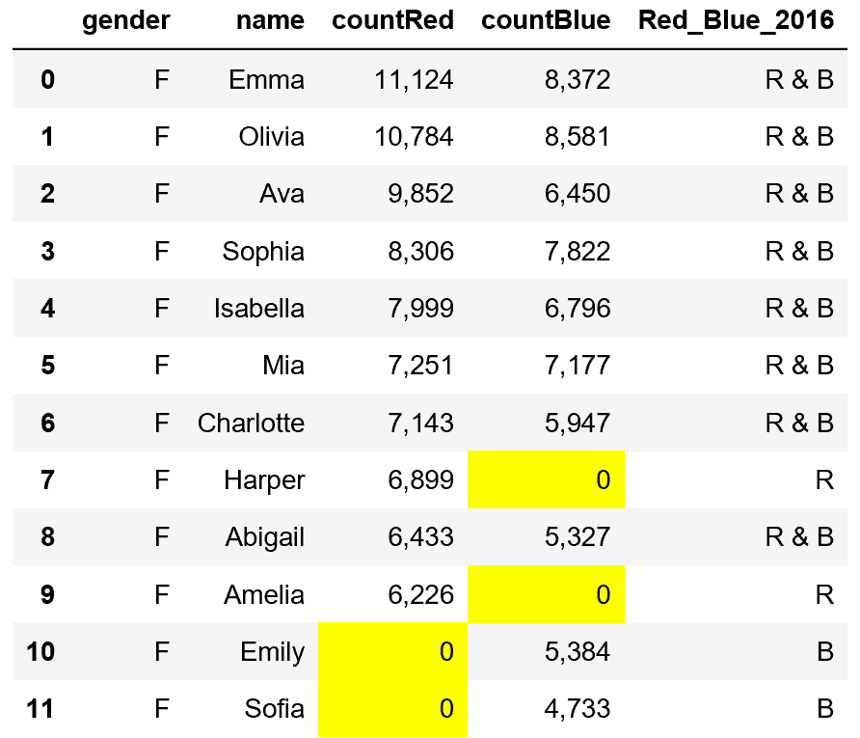
Top Girl Names

Slide 20
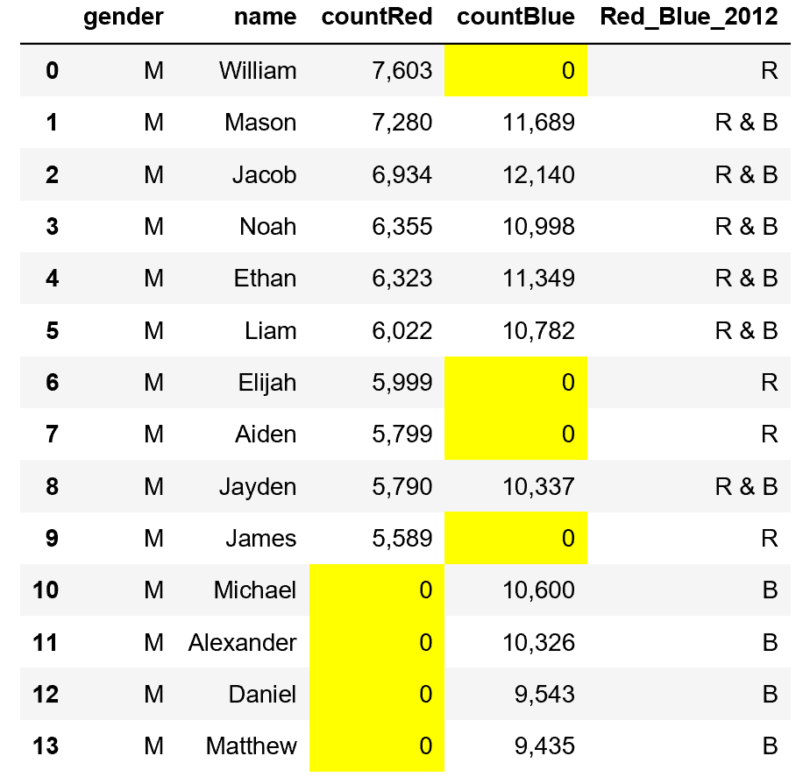
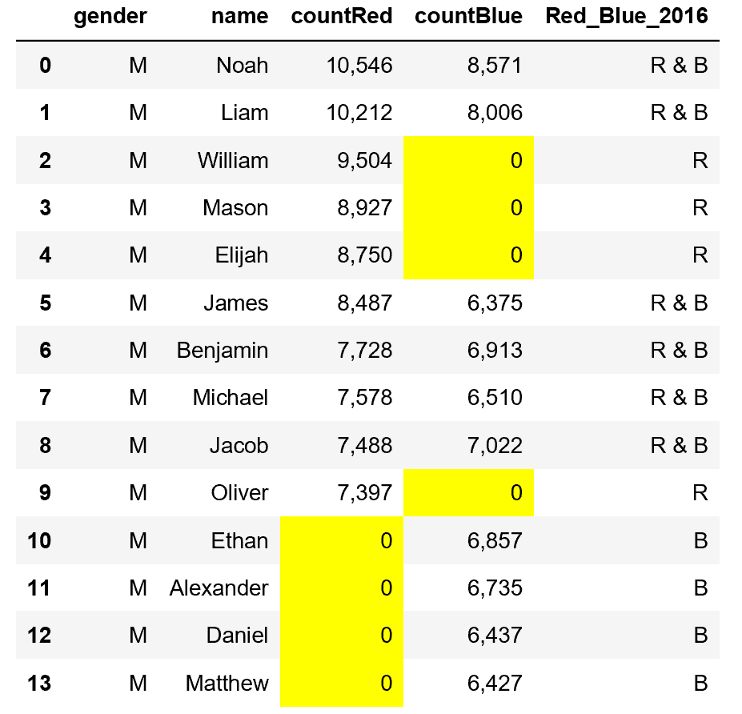
Top Boy Names

Slide 21
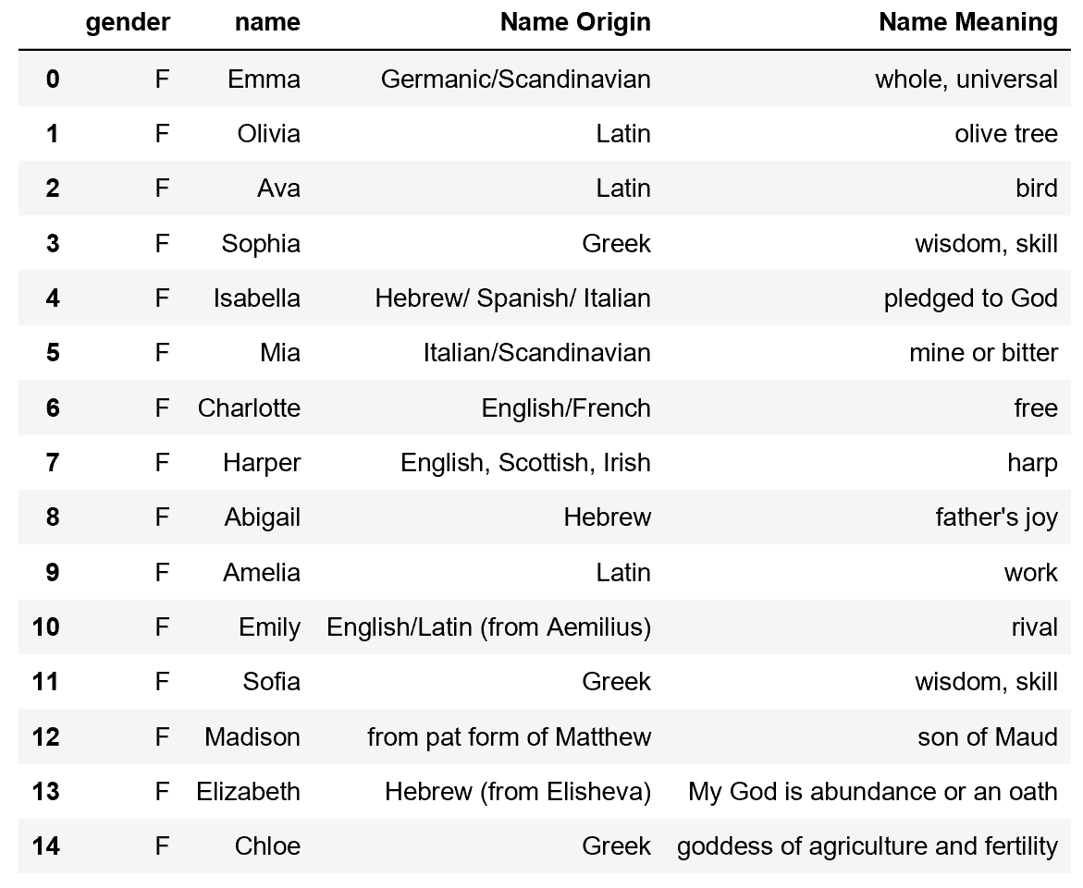
Origin of top Girl Names

Slide 22
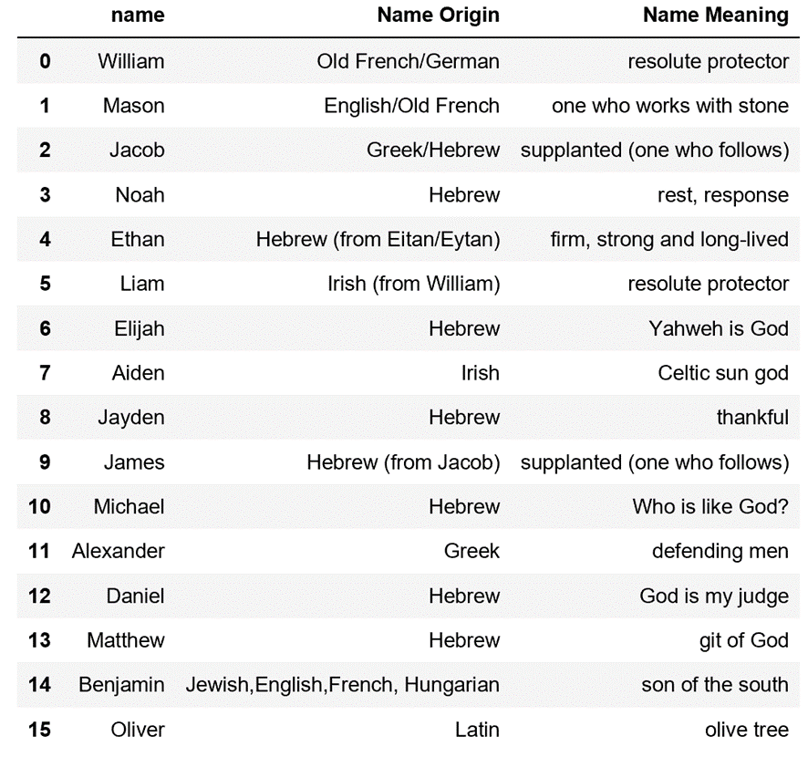
Origin of top Boy Names

Slide 23
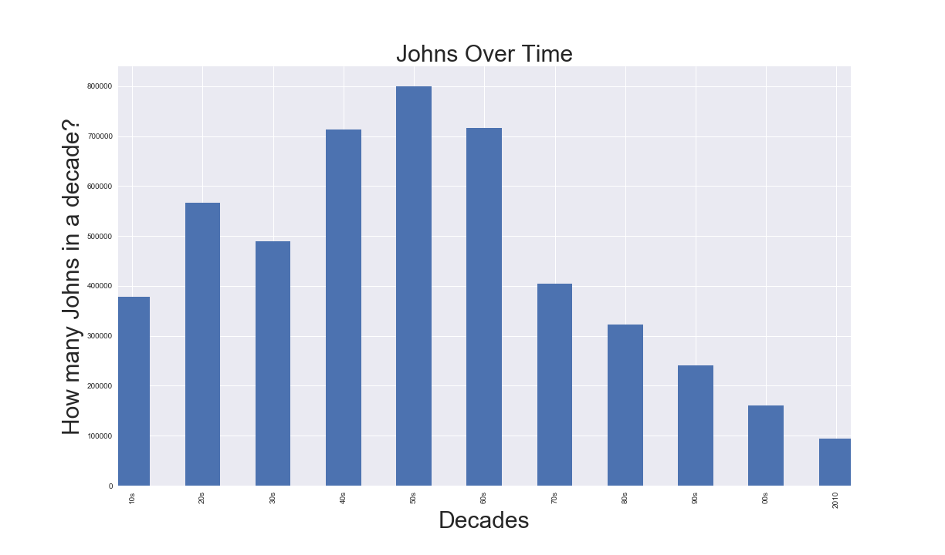
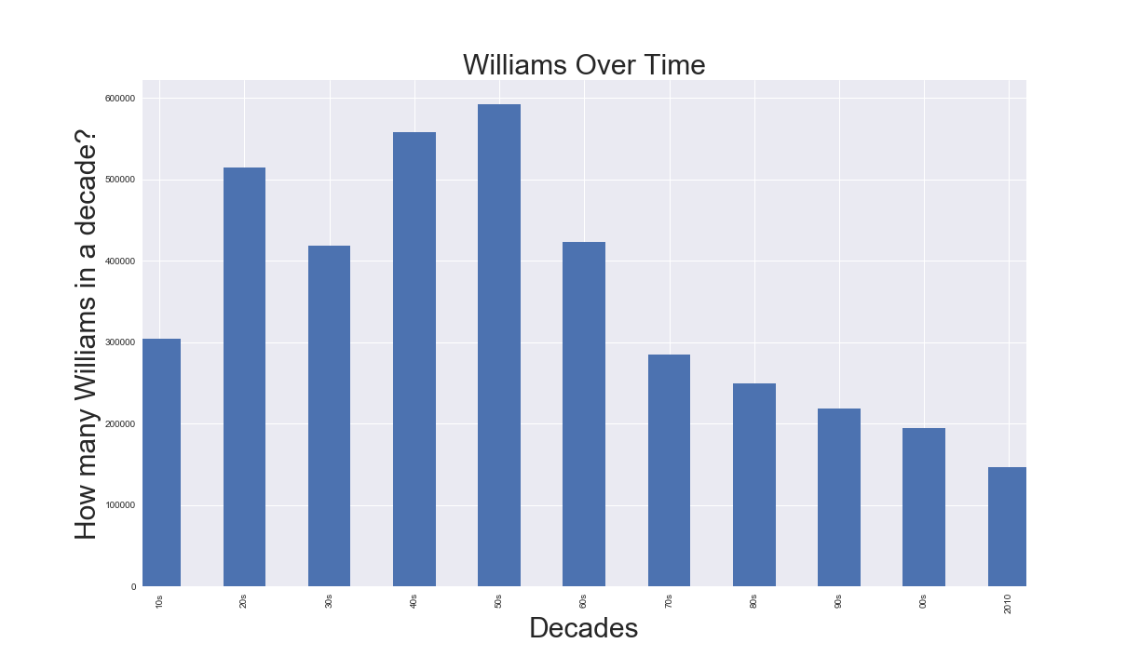
Findings

Slide 24
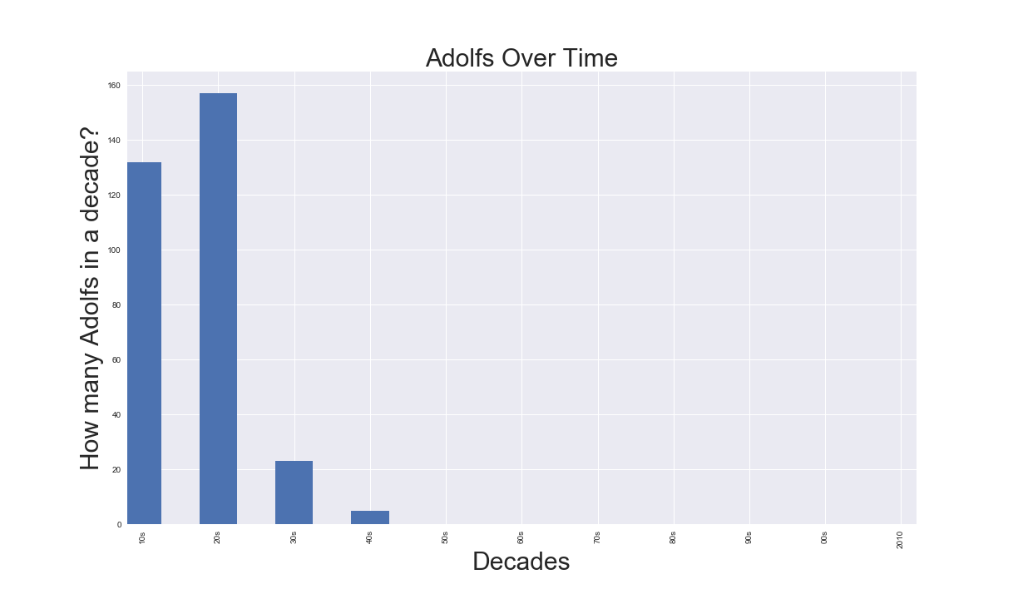
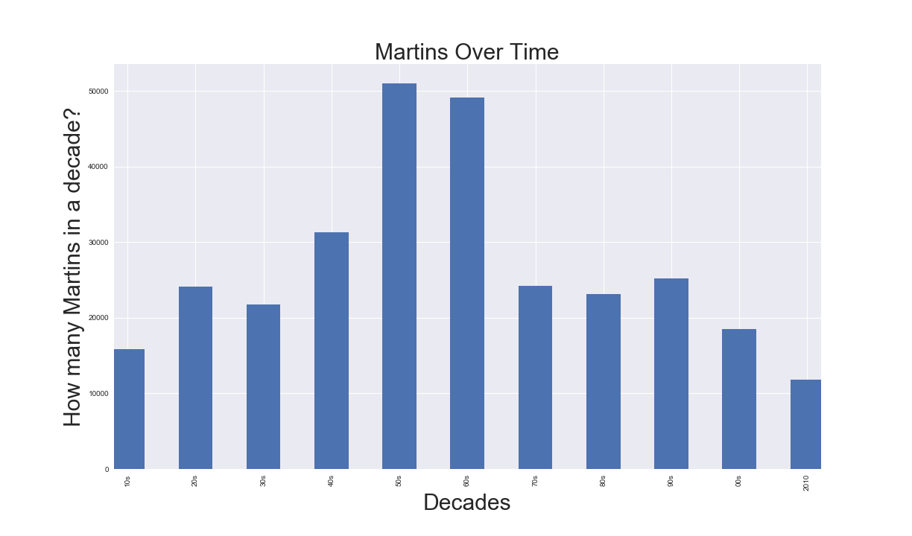
Findings

Slide 25
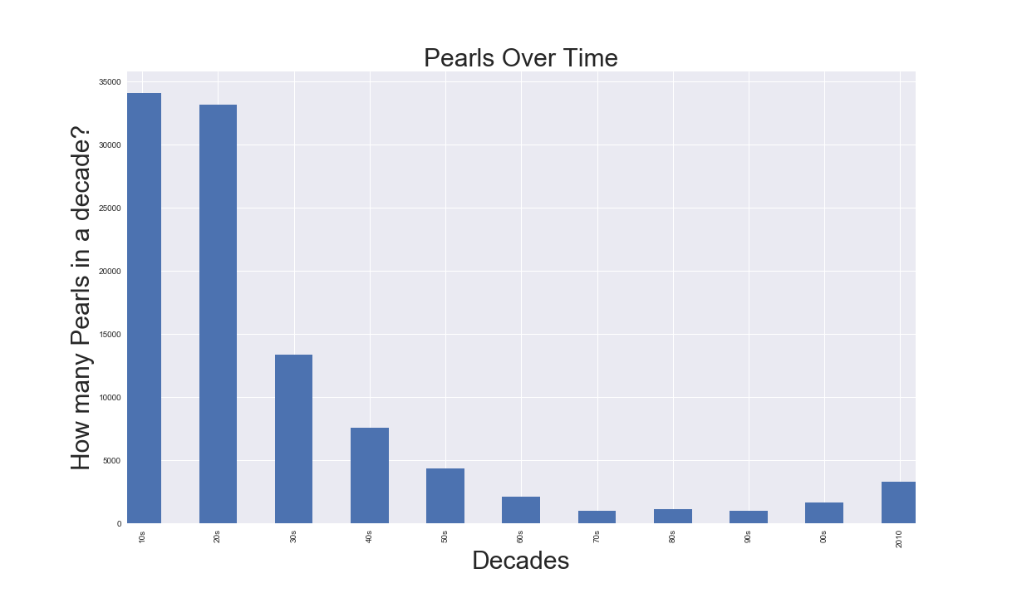
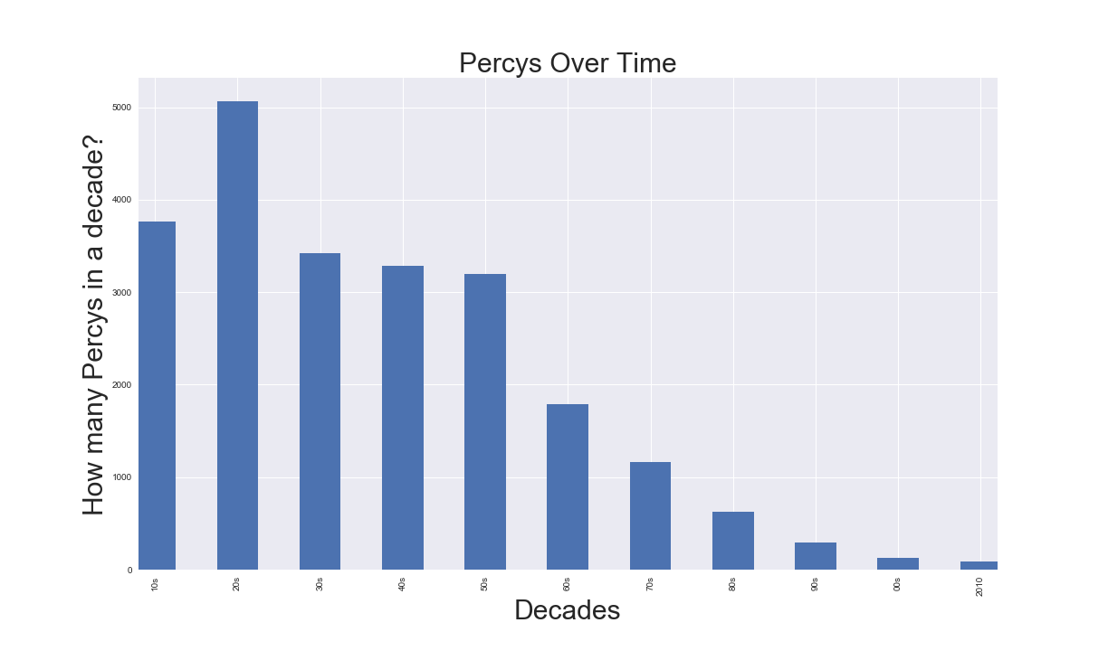
Findings

Slide 26
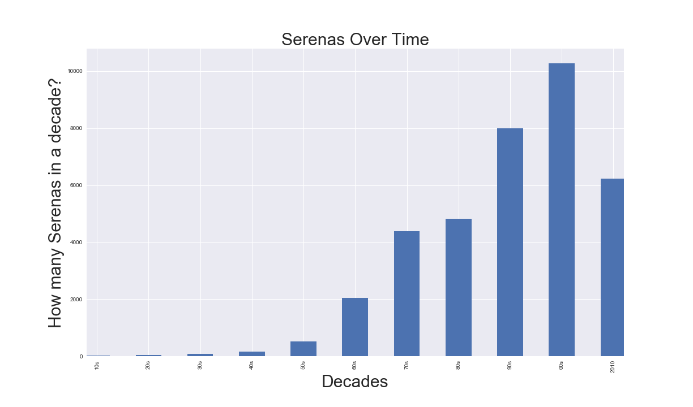
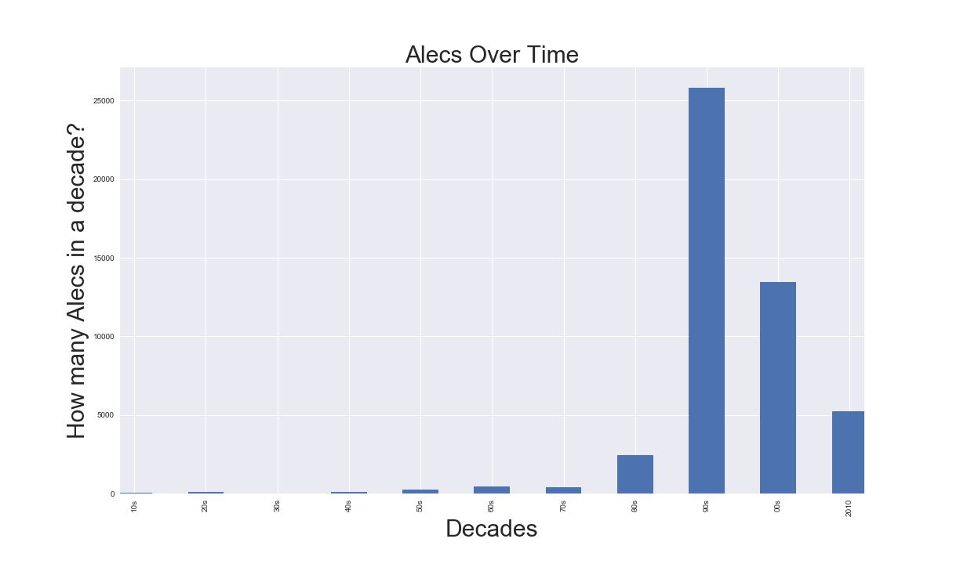
Findings

Slide 27
Discussion
The surprising ubiquity of the most popular names
The resiliency of popular names across time
Less popular names can see a spike due to popular culture
Timing of popularity spikes vs a celebrity's popularity
Notoriety can cause a name to decrease in popularity

Slide 28
Issues & Limitations
Dataset is 52% male but there is a higher diversity of girl's names
Difficult to analyze some names due to unique spelling
Popularity is an abstract measure – tough to judge using data only
Popular names will have popularity regardless of celebrities in pop culture
A popular name will also tend to have more celebrities with the name
Technical limitations occurred when attempting to produce a map with names tied to specific states
Pulled celebrity data from Wikipedia but was unable to clean data using pandas

